Slide 1


Slide 2
De Oranje Avond
Mede mogelijk gemaakt door:
Greenpeace
S. Shekelstein
L.S.V. Minerva
Rabobank
CPN | 0 | PSP | 0 | GL | 0 | Pv dA | 0 | DNL | 0 | D66 | 0 | VVD | 0 | PVV | 0 | GPN | 0

Slide 3
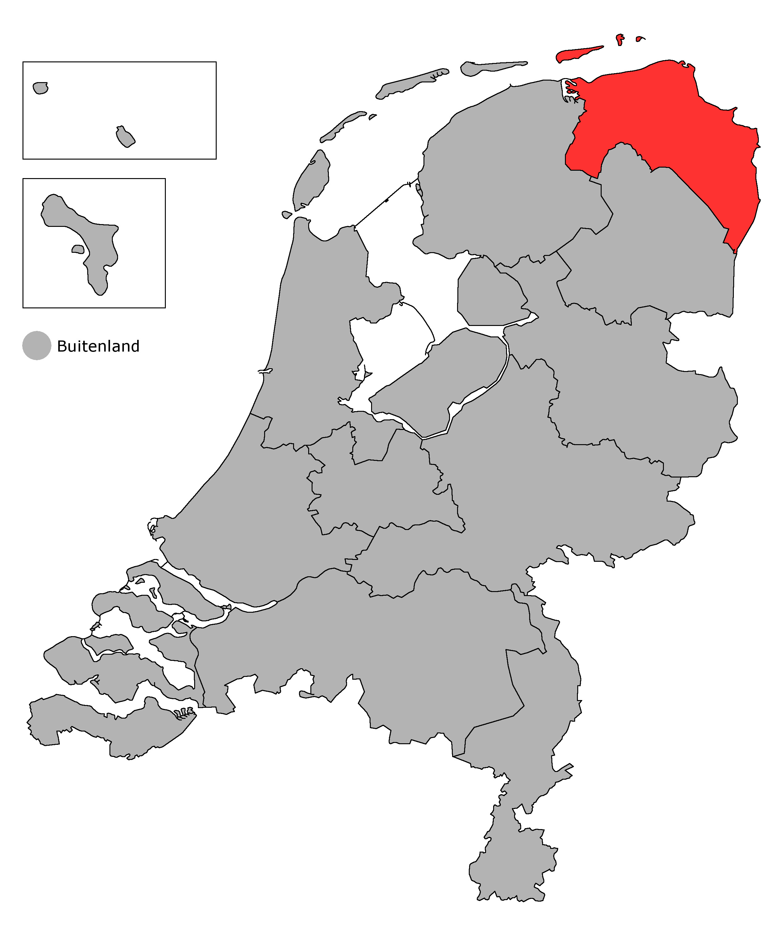
Groningen
CPN | 0 | PSP | 0 | GL | 0 | Pv dA | 0 | DNL | 0 | D66 | 0 | VVD | 0 | PVV | 0 | GPN | 0

Slide 4
Groningen
Coalities
L | +15
BL | +15
R | +15
BR | +15
CNM | +15
CNM+ | +15
TH8 | +15
BL+ | +15
BR+ | +15
Stemmen
CPN | 4
PSP | 2
GL | 3
PvdA | 0
DNL | 1
D66 | 2
VVD | 1
PVV | 3
GPN | 1
CPN | 0 | PSP | 0 | GL | 0 | Pv dA | 0 | DNL | 0 | D66 | 0 | VVD | 0 | PVV | 0 | GPN | 0

Slide 5
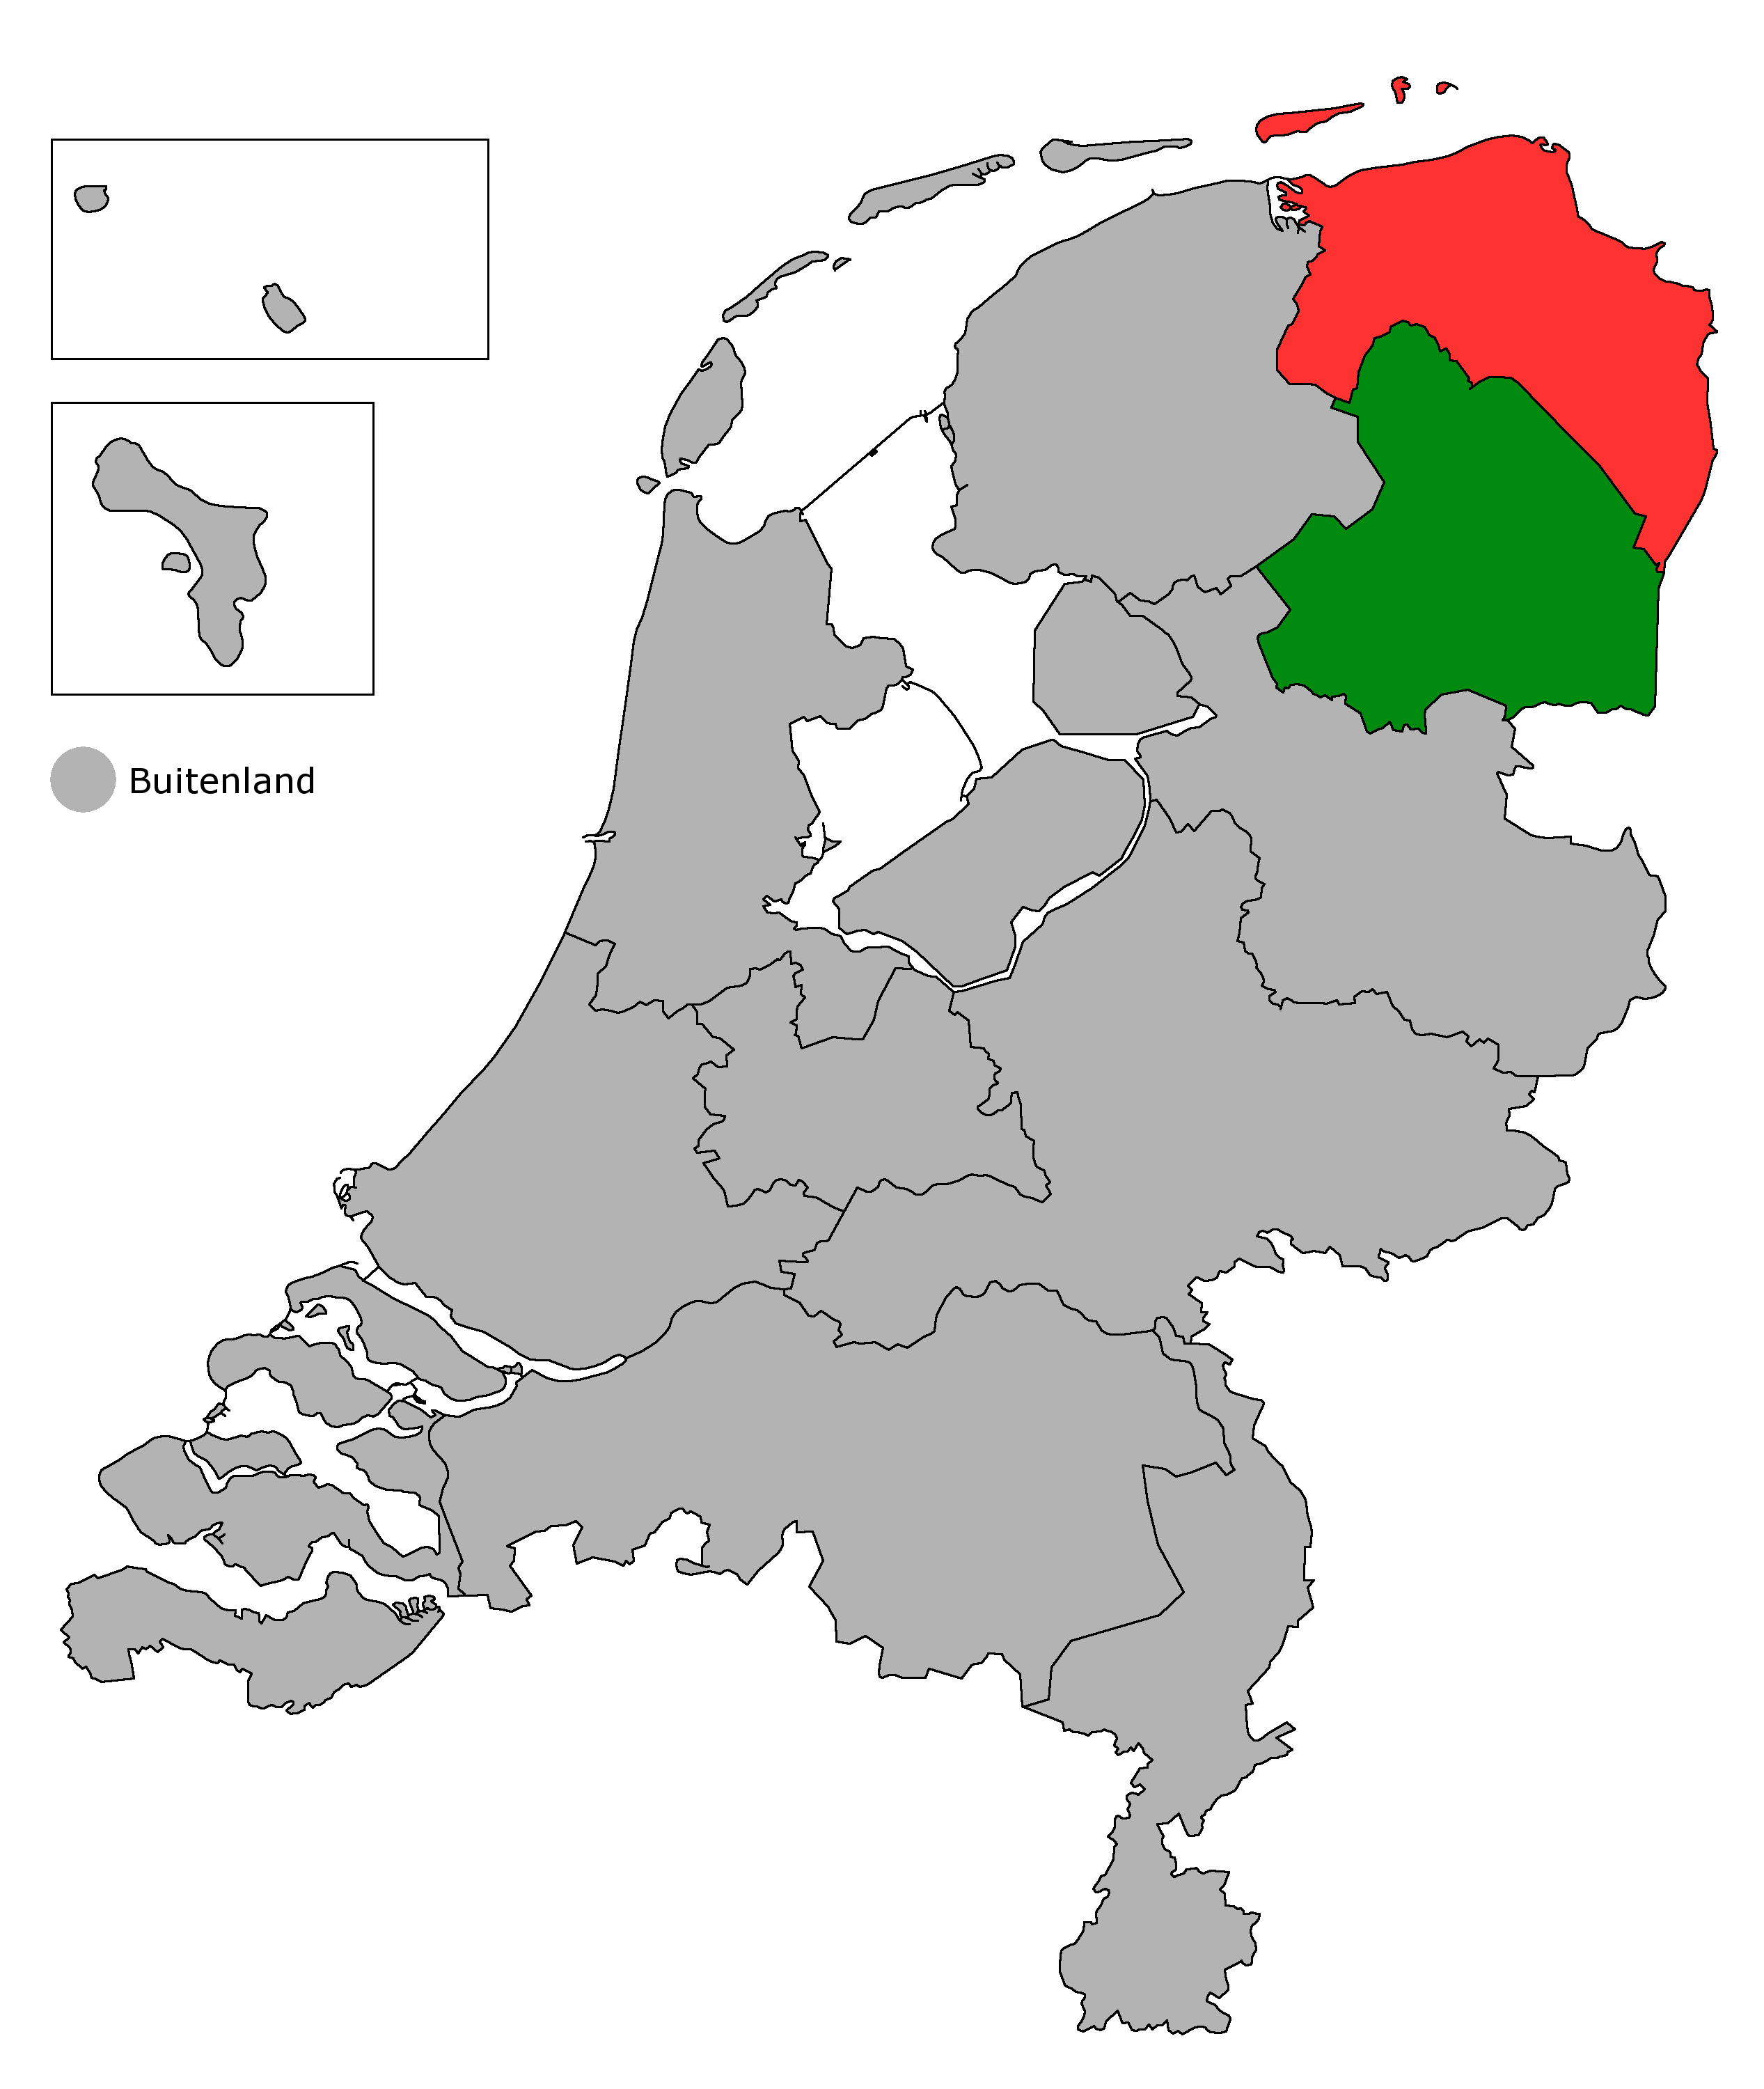
Drenthe
CPN | 0 | PSP | 0 | GL | 0 | Pv dA | 0 | DNL | 0 | D66 | 0 | VVD | 0 | PVV | 0 | GPN | 0

Slide 6
Drenthe
Coalities
L | +15
BL | +15
R | +15
BR | +15
CNM | +15
CNM+ | +15
TH8 | +15
BL+ | +15
BR+ | +15
Stemmen
CPN | 1
PSP | 0
GL | 2
PvdA | 0
DNL | 0
D66 | 3
VVD | 0
PVV | 1
GPN | 1
CPN | 0 | PSP | 0 | GL | 0 | Pv dA | 0 | DNL | 0 | D66 | 0 | VVD | 0 | PVV | 0 | GPN | 0

Slide 7
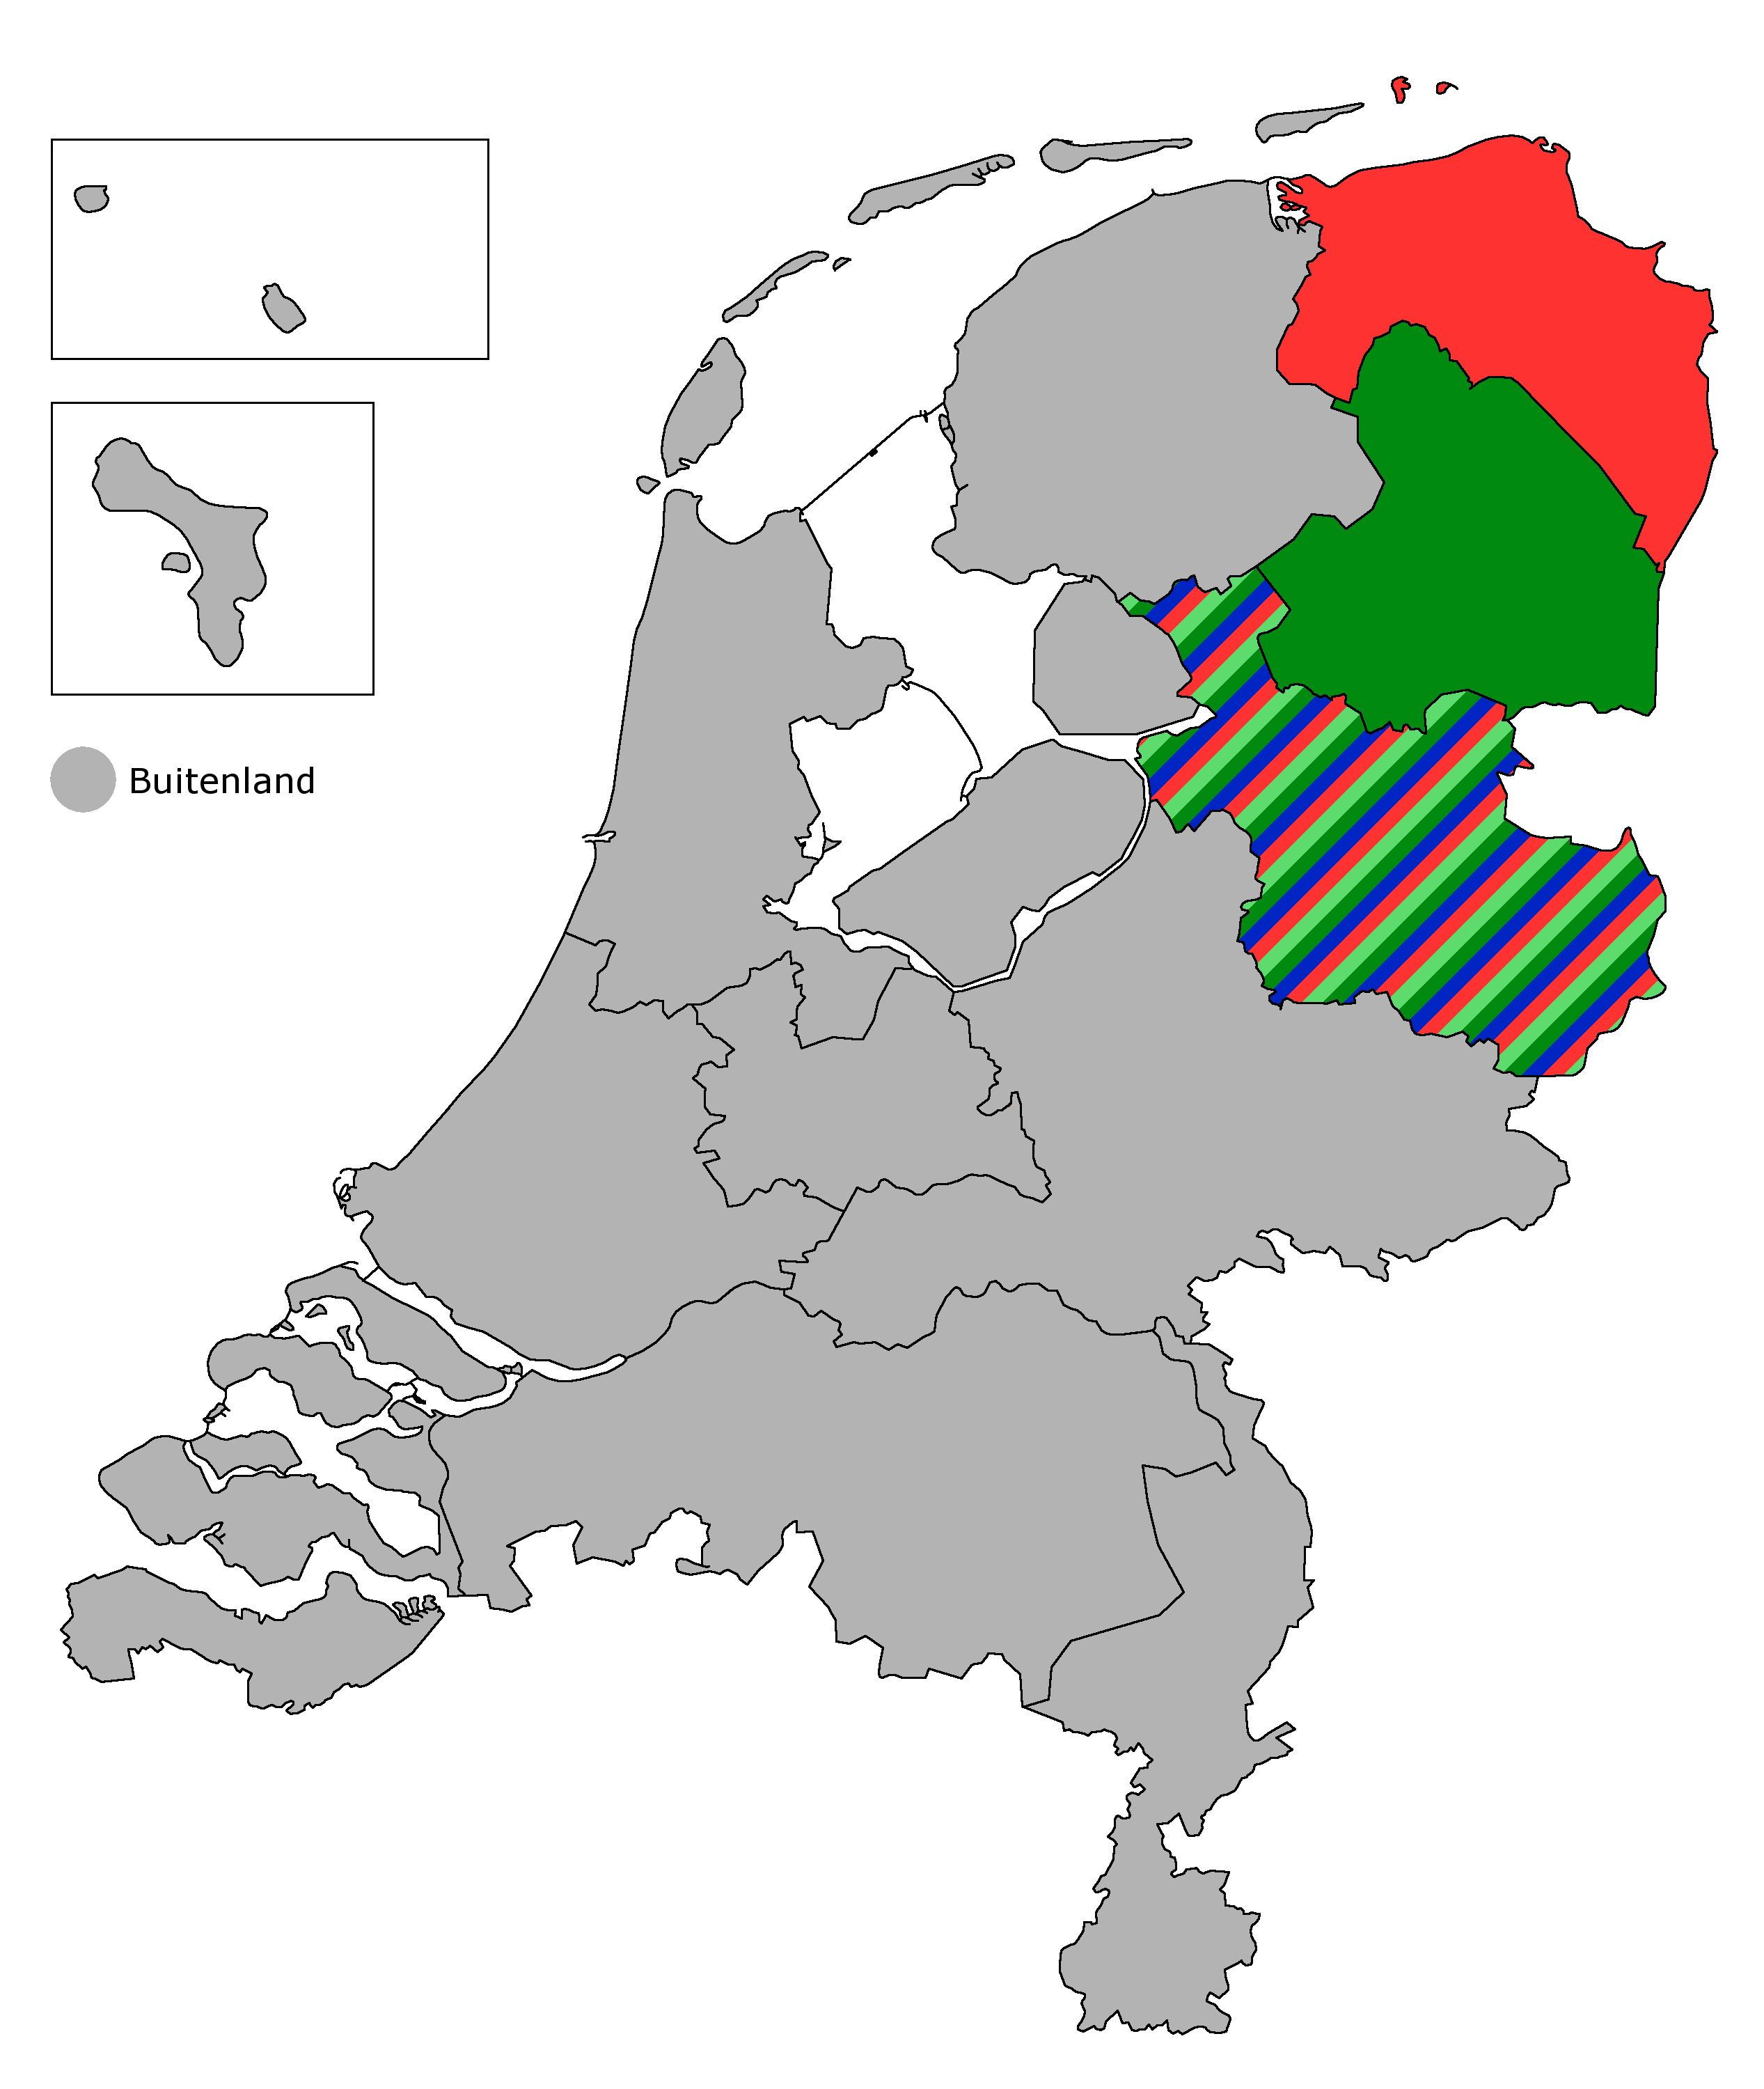
Overijssel
CPN | 0 | PSP | 0 | GL | 0 | Pv dA | 0 | DNL | 0 | D66 | 0 | VVD | 0 | PVV | 0 | GPN | 0

Slide 8
Overijssel
Coalities
L | +15
BL | +15
R | +15
BR | +15
CNM | +15
CNM+ | +15
TH8 | +15
BL+ | +15
BR+ | +15
Stemmen
CPN | 2
PSP | 1
GL | 1
PvdA | 0
DNL | 0
D66 | 1
VVD | 2
PVV | 1
GPN | 2
CPN | 0 | PSP | 0 | GL | 0 | Pv dA | 0 | DNL | 0 | D66 | 0 | VVD | 0 | PVV | 0 | GPN | 0

Slide 9
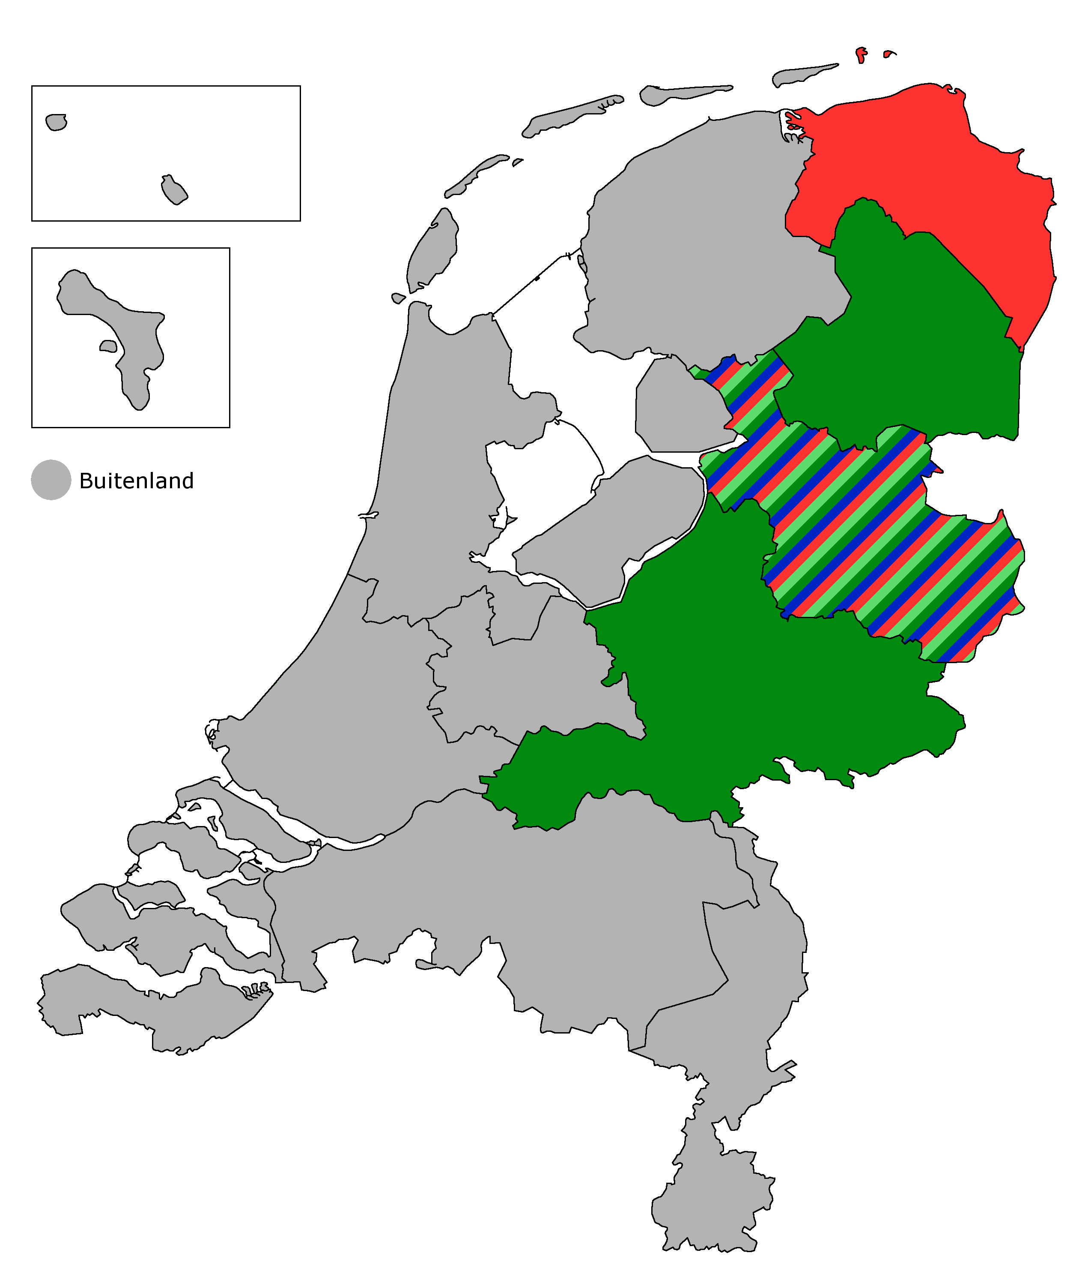
Gelderland
CPN | 0 | PSP | 0 | GL | 0 | Pv dA | 0 | DNL | 0 | D66 | 0 | VVD | 0 | PVV | 0 | GPN | 0

Slide 10
Gelderland
Coalities
L | +14
BL | +14
R | +13
BR | +13
CNM | +13
CNM+ | +13
TH8 | +14
BL+ | +14
BR+ | +13
Stemmen
CPN | 1
PSP | 3
GL | 4
PvdA | 4
DNL | 4
D66 | 10
VVD | 2
PVV | 2
GPN | 2
CPN | 1 | PSP | 0 | GL | 0 | Pv dA | 0 | DNL | 0 | D66 | 2 | VVD | 0 | PVV | 0 | GPN | 0

Slide 11
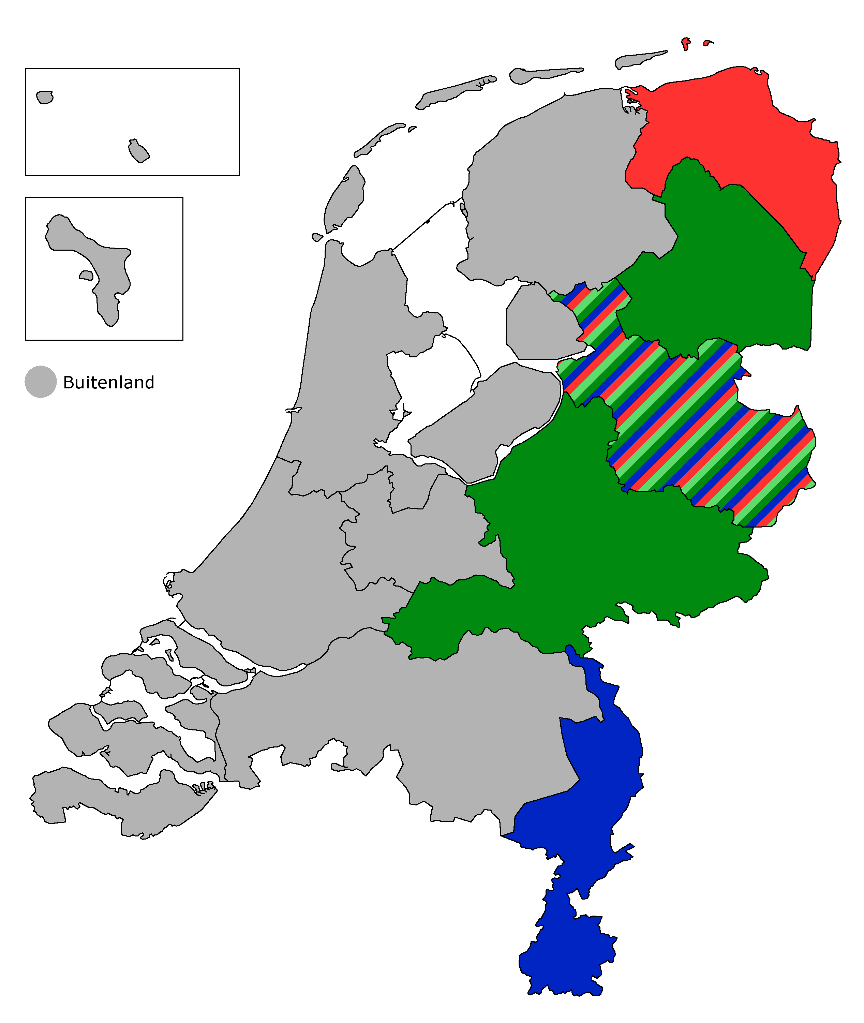
Limburg
CPN | 0 | PSP | 0 | GL | 0 | Pv dA | 0 | DNL | 0 | D66 | 0 | VVD | 0 | PVV | 0 | GPN | 0

Slide 12
Limburg
Coalities
L | +13
BL | +13
R | +12
BR | +12
CNM | +12
CNM+ | +12
TH8 | +13
BL+ | +13
BR+ | +12
Stemmen
CPN | 0
PSP | 0
GL | 2
PvdA | 0
DNL | 0
D66 | 1
VVD | 3
PVV | 0
GPN | 1
CPN | 1 | PSP | 0 | GL | 1 | Pv dA | 1 | DNL | 0 | D66 | 2 | VVD | 1 | PVV | 0 | GPN | 0

Slide 13
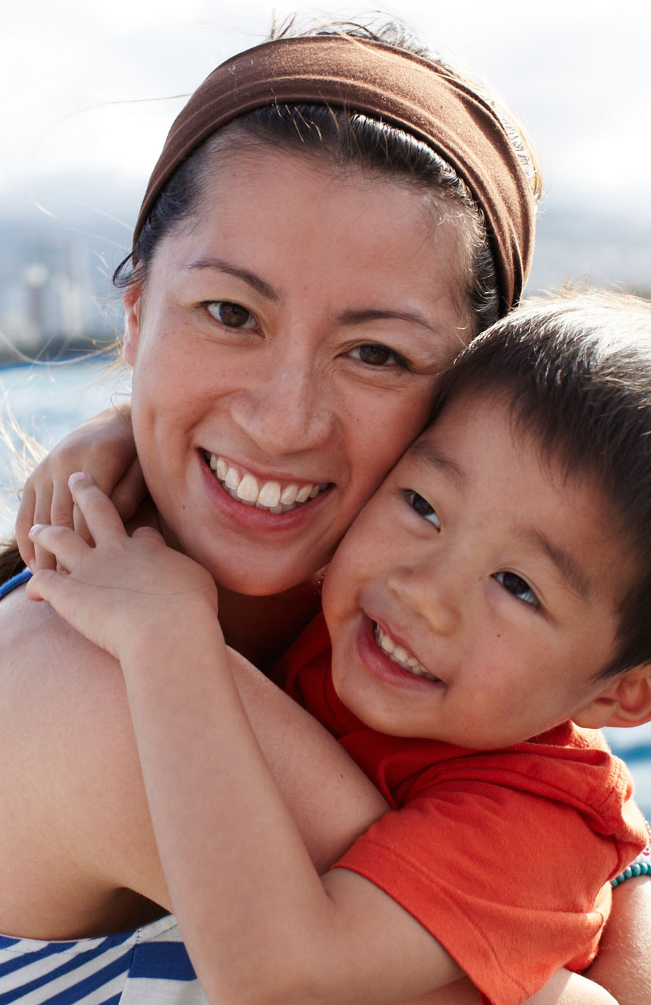
Groningen
CPN | 0 | PSP | 0 | GL | 0 | Pv dA | 0 | DNL | 0 | D66 | 0 | VVD | 0 | PVV | 0 | GPN | 0

Slide 14
Groningen
Coalities
L | 0
BL | 0
R | 0
BR | 0
CNM | 0
CNM+ | 0
TH8 | 0
BL+ | 0
BR+ | 0
Stemmen
CPN | 4
PSP | 2
GL | 3
PvdA | 0
DNL | 1
D66 | 2
VVD | 1
PVV | 3
GPN | 1
CPN | 0 | PSP | 0 | GL | 0 | Pv dA | 0 | DNL | 0 | D66 | 0 | VVD | 0 | PVV | 0 | GPN | 0

Slide 15
Groningen
CPN | 0 | PSP | 0 | GL | 0 | Pv dA | 0 | DNL | 0 | D66 | 0 | VVD | 0 | PVV | 0 | GPN | 0

Slide 16
Groningen
Coalities
L | 0
BL | 0
R | 0
BR | 0
CNM | 0
CNM+ | 0
TH8 | 0
BL+ | 0
BR+ | 0
Stemmen
CPN | 4
PSP | 2
GL | 3
PvdA | 0
DNL | 1
D66 | 2
VVD | 1
PVV | 3
GPN | 1
CPN | 0 | PSP | 0 | GL | 0 | Pv dA | 0 | DNL | 0 | D66 | 0 | VVD | 0 | PVV | 0 | GPN | 0

Slide 17
Groningen
CPN | 0 | PSP | 0 | GL | 0 | Pv dA | 0 | DNL | 0 | D66 | 0 | VVD | 0 | PVV | 0 | GPN | 0

Slide 18
Groningen
Coalities
L | 0
BL | 0
R | 0
BR | 0
CNM | 0
CNM+ | 0
TH8 | 0
BL+ | 0
BR+ | 0
Stemmen
CPN | 4
PSP | 2
GL | 3
PvdA | 0
DNL | 1
D66 | 2
VVD | 1
PVV | 3
GPN | 1
CPN | 0 | PSP | 0 | GL | 0 | Pv dA | 0 | DNL | 0 | D66 | 0 | VVD | 0 | PVV | 0 | GPN | 0

Slide 19
Groningen
CPN | 0 | PSP | 0 | GL | 0 | Pv dA | 0 | DNL | 0 | D66 | 0 | VVD | 0 | PVV | 0 | GPN | 0

Slide 20
Groningen
Coalities
L | 0
BL | 0
R | 0
BR | 0
CNM | 0
CNM+ | 0
TH8 | 0
BL+ | 0
BR+ | 0
Stemmen
CPN | 4
PSP | 2
GL | 3
PvdA | 0
DNL | 1
D66 | 2
VVD | 1
PVV | 3
GPN | 1
CPN | 0 | PSP | 0 | GL | 0 | Pv dA | 0 | DNL | 0 | D66 | 0 | VVD | 0 | PVV | 0 | GPN | 0

Slide 21
Groningen
CPN | 0 | PSP | 0 | GL | 0 | Pv dA | 0 | DNL | 0 | D66 | 0 | VVD | 0 | PVV | 0 | GPN | 0

Slide 22
Groningen
Coalities
L | 0
BL | 0
R | 0
BR | 0
CNM | 0
CNM+ | 0
TH8 | 0
BL+ | 0
BR+ | 0
Stemmen
CPN | 4
PSP | 2
GL | 3
PvdA | 0
DNL | 1
D66 | 2
VVD | 1
PVV | 3
GPN | 1
CPN | 0 | PSP | 0 | GL | 0 | Pv dA | 0 | DNL | 0 | D66 | 0 | VVD | 0 | PVV | 0 | GPN | 0

Slide 23
Groningen
CPN | 0 | PSP | 0 | GL | 0 | Pv dA | 0 | DNL | 0 | D66 | 0 | VVD | 0 | PVV | 0 | GPN | 0

Slide 24
Groningen
Coalities
L | 0
BL | 0
R | 0
BR | 0
CNM | 0
CNM+ | 0
TH8 | 0
BL+ | 0
BR+ | 0
Stemmen
CPN | 4
PSP | 2
GL | 3
PvdA | 0
DNL | 1
D66 | 2
VVD | 1
PVV | 3
GPN | 1
CPN | 0 | PSP | 0 | GL | 0 | Pv dA | 0 | DNL | 0 | D66 | 0 | VVD | 0 | PVV | 0 | GPN | 0

Slide 25
Groningen
CPN | 0 | PSP | 0 | GL | 0 | Pv dA | 0 | DNL | 0 | D66 | 0 | VVD | 0 | PVV | 0 | GPN | 0

Slide 26
Groningen
Coalities
L | 0
BL | 0
R | 0
BR | 0
CNM | 0
CNM+ | 0
TH8 | 0
BL+ | 0
BR+ | 0
Stemmen
CPN | 4
PSP | 2
GL | 3
PvdA | 0
DNL | 1
D66 | 2
VVD | 1
PVV | 3
GPN | 1
CPN | 0 | PSP | 0 | GL | 0 | Pv dA | 0 | DNL | 0 | D66 | 0 | VVD | 0 | PVV | 0 | GPN | 0

Slide 27
Groningen
CPN | 0 | PSP | 0 | GL | 0 | Pv dA | 0 | DNL | 0 | D66 | 0 | VVD | 0 | PVV | 0 | GPN | 0

Slide 28
Groningen
Coalities
L | 0
BL | 0
R | 0
BR | 0
CNM | 0
CNM+ | 0
TH8 | 0
BL+ | 0
BR+ | 0
Stemmen
CPN | 4
PSP | 2
GL | 3
PvdA | 0
DNL | 1
D66 | 2
VVD | 1
PVV | 3
GPN | 1
CPN | 0 | PSP | 0 | GL | 0 | Pv dA | 0 | DNL | 0 | D66 | 0 | VVD | 0 | PVV | 0 | GPN | 0

Slide 29
Groningen
CPN | 0 | PSP | 0 | GL | 0 | Pv dA | 0 | DNL | 0 | D66 | 0 | VVD | 0 | PVV | 0 | GPN | 0

Slide 30
Groningen
Coalities
L | 0
BL | 0
R | 0
BR | 0
CNM | 0
CNM+ | 0
TH8 | 0
BL+ | 0
BR+ | 0
Stemmen
CPN | 4
PSP | 2
GL | 3
PvdA | 0
DNL | 1
D66 | 2
VVD | 1
PVV | 3
GPN | 1
CPN | 0 | PSP | 0 | GL | 0 | Pv dA | 0 | DNL | 0 | D66 | 0 | VVD | 0 | PVV | 0 | GPN | 0

Slide 31
Groningen
CPN | 0 | PSP | 0 | GL | 0 | Pv dA | 0 | DNL | 0 | D66 | 0 | VVD | 0 | PVV | 0 | GPN | 0

Slide 32
Groningen
Coalities
L | 0
BL | 0
R | 0
BR | 0
CNM | 0
CNM+ | 0
TH8 | 0
BL+ | 0
BR+ | 0
Stemmen
CPN | 4
PSP | 2
GL | 3
PvdA | 0
DNL | 1
D66 | 2
VVD | 1
PVV | 3
GPN | 1
CPN | 0 | PSP | 0 | GL | 0 | Pv dA | 0 | DNL | 0 | D66 | 0 | VVD | 0 | PVV | 0 | GPN | 0

